Slide 1
Estate Planning Council of Greater Miami
Conflicts, Communication, & Consent:
Ethical Issues in Trust & Estate Law
November 17, 2016

Slide 2
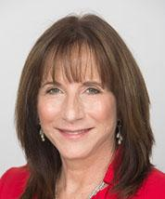
Professional Responsibility &
Ethics Program
Jan Jacobowitz Director
Vincent
Calarco
Fellow
Marissa
Shulman
Intern
Elizabeth
Gil
Fellow

Slide 3
Act I
Better a Witty Fool Than a Foolish Lawyer

Slide 4
Question 1: What are the ethical implications of:
Juliet using money from Capulet’s estate to invest in four real estate properties?

Slide 5
Tuscany Rome
Estate Funds used for Investments

Slide 6
Personal Representative
Florida Statutes
Fla. Statute §732.602 Personal Representative
Ethics Rules
Fla. Rule 4-1.2(a) Objectives and Scope of Representation
Fla. Rule 4-1.4 Communication
Fla. Rule 4-1.7 Conflict of Interest; Current Clients
Fla. Rule 4-8.4 Misconduct
Case Law
The Florida Bar v. Swann, 116 So.3d 1225 (Fla. 2013)
State v. Lahurd, 632 So.2d 1101 (Fla. Dist. Ct. App. 1994)
The Florida Bar v. Wolf, 605 So.2d 461 (Fla. 1992)

Slide 7
Question 2: What are the ethical implications of:
Juliet allowing a client to reside in one of the properties at a reduced rent?

Slide 8
Offering a helping hand

Slide 9
For Rent?
Florida Statutes
Fla. Statute §732.602 Personal Representative
Ethics Rules
Fla. Rule 4-1.2(a) Objectives and Scope of Representation
Fla. Rule 4-1.4 Communication
Fla. Rule 4-1.7 Conflict of Interest; Current Clients
Fla. Rule 4-8.4 Misconduct
Case Law
The Florida Bar v. Swann, 116 So.3d 1225 (Fla. 2013)
State v. Lahurd, 632 So.2d 1101 (Fla. Dist. Ct. App. 1994)
The Florida Bar v. Wolf, 605 So.2d 461 (Fla. 1992)
RENTED

Slide 10
Question 3: What are the ethical implications of:
Juliet’s lack of documentation for the unaccounted $50,000?

Slide 11
Documentation
Florida Statutes
Fla. Statute §732.602 Personal Representative
Ethics Rules
Fla. Rule 4-1.2(a) Objectives and Scope of Representation
Fla. Rule 4-1.4 Communication
Fla. Rule 4-1.7 Conflict of Interest; Current Clients
Fla. Rule 4-8.4 Misconduct
Case Law
The Florida Bar v. Swann, 116 So.3d 1225 (Fla. 2013)
State v. Lahurd, 632 So.2d 1101 (Fla. Dist. Ct. App. 1994)
The Florida Bar v. Wolf, 605 So.2d 461 (Fla. 1992)

Slide 12
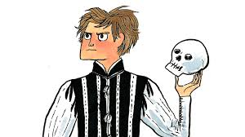
Act II
To Gift or
Not to gift?

Slide 13
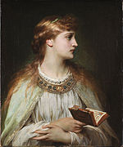
Ophelia and Her Client
Part A

Slide 14
Question 1
WHAT ARE THE ETHICAL Implications of Ophelia’s Behavior?

Slide 15
1. Relationship to Drafter 2. Substantial Gift 3. Communication 4. Conflict of Interest 5. Independent Counsel
OPHELIA’S ETHICAL IMPLICATIONS
Florida Statutes (Probate Code)
Fla. Statute §732.806
Ethics Rules
Fla. Rule 4-1.2(a) Objectives and Scope of Representation
Fla. Rule 4-1.4 Communication
Fla. Rule 4-1.7 Conflict of Interest; Current Clients
Fla. Rule 4-1.8(c) Prohibited and Other Transactions
ACTEC Commentaries
Restatement (Third) of Law Governing Lawyers

Slide 16
Question 2
What are some possible consequences of Ophelia’s Actions?

Slide 17
1. Disproportionate Gift 2. Claims of Undue Influence 3. Burden of persuasion 4. Voided gift?
POSSIBLE CONSEQUENCES FOR OPHELIA
Florida Case
In re Estate of Murphy, Case 06-6744ES-4 (Fla. Cir. Ct. for Pinellas County, August 1, 2008)

Slide 18
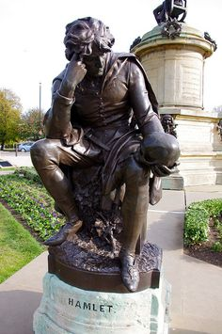
Part B
Hamlet and His Client

Slide 19
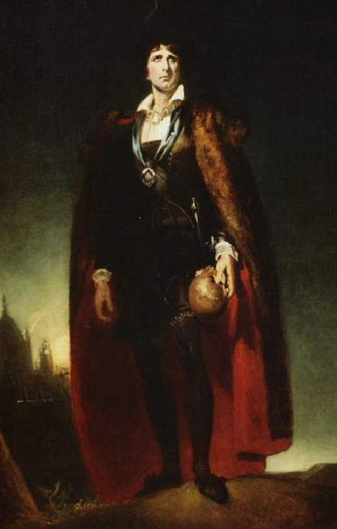
Question 1
What are the ethical implications of Hamlet’s Behavior?

Slide 20
1. Relationship to Drafter 2. Execution in Same Firm 3. Waiver 4. Incapacity 5. Simple Gift Acceptance
HAMLET’S ETHICAL IMPLICATIONS
Ethics Rules
Fla. Rule 4-1.1 Competence
Fla. Rule 4-1.3 Diligence
Fla. Rule 4-1.8(k) Imputation of Conflicts
Fla. Rule 4-1.10 Imputation of Conflicts of Interest
Ethics Opinions
Los Angeles County Bar Association
Relevant Cases
In re Colman, 885 N.E.2d 1238 (Ind. 2008)
Florida Bar v. Poe, 786 So. 2d 1164, Supreme Court of Florida (2001)
ABA Model Rule 1.8(c)
Restatement (Third) of Law Governing Lawyers
Florida Statutes (Probate Code)
Fla. Statute §732.806

Slide 21
Question 2
What are some possible consequences of hamlet’s Actions?

Slide 22
1. Non-Relative Suspect 2. Claims of Undue Influence 3. Voided gift or will? 4. Fines and Disbarment
POSSIBLE CONSEQUENCES FOR HAMLET
Florida Statute § 732.5165
Ethics Opinion
New York State Bar Association
Florida Standards for Imposing Lawyer Sanctions
Rule 4.31(a)
Rule 4.32
Rule 4.43
Rule 4.51

Slide 23
Act III
I Trust that is not okay

Slide 24
Question 1: What are the ethical implications of:
Romeo Suggesting that he become Juliet’s Trustee?

Slide 25
Lawyer as Trustee
ACTEC Commentaries
Ethics Rules
Fla. Rule 4-1.1 Competence
Fla. Rule 4-1.4 Communication
Fla. Rule 4-1.7 Conflicts of Interest
Fla. Rule 4-1.8 Prohibited & Other Transactions
Ethics Opinion
ABA Formal Opinion 02-426
Best Practice Tips
Confirm the client’s decision in writing
Urge client to obtain independent advice

Slide 26
Question 2: What are the ethical implications of:
The exculpatory clause in the trust?

Slide 27
Exculpation of the Trustee
Fla. Stat. §736.1011.
Factors to Consider:
The extent of the prior relationship between the settlor and trustee
Whether the settlor received independent advice
The sophistication of the settlor with respect to business and fiduciary matters;
The trustee’s reasons for inserting the clause;
The scope of the particular provision inserted.

Slide 28
Question 3: What are the ethical implications of:
The veto power provision in the trust?

Slide 29
Veto Power
Ethics Rules
Fla. Rule 4-1.4(b) Communication
Cases
In re Matter of Wayne H. Eisenhauer, 427 Mass. 448 (Mass. 1998).

Slide 30
Question 4: What are the ethical implications of:
Juliet’s execution of the trust?

Slide 31
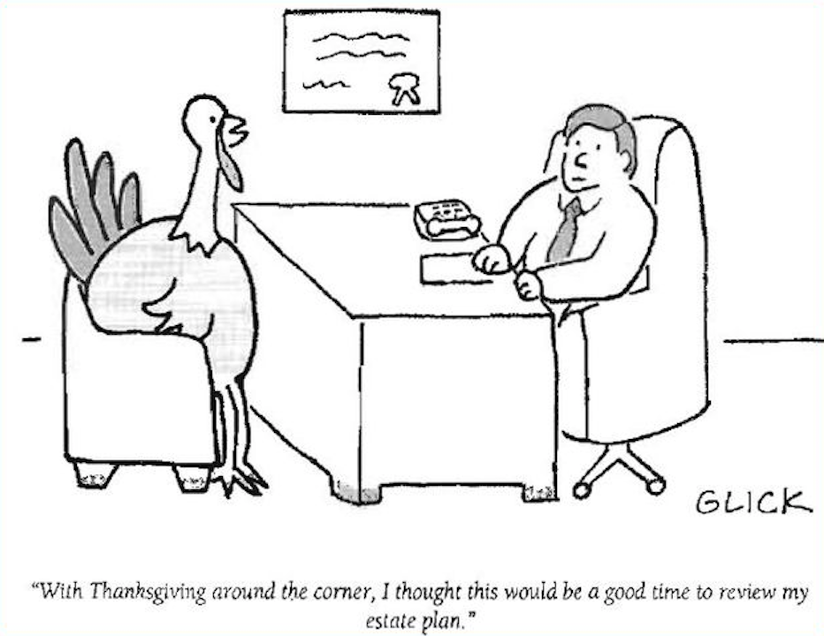
Execution of the Trust
Ethics Rules
Fla. Rule 4-1.2 Scope of Representation
Fla. Rule 4-1.4(b) Communication

